Slide 1
Working with Sessions
HTTP Stateless Protocol, Client Side Storage, PHP Sessions, PHP Superglobals, Authentication
SoftUni Team
Technical Trainers
Software University
http://softuni.bg

Slide 2
Have a Question?
sli.do
#php-web

Slide 3
Table of Contents
HTTP Stateless Protocol
Client Side Storage
Web Storage API
Cookies
PHP Sessions
Other Superglobals
Authentication

Slide 4
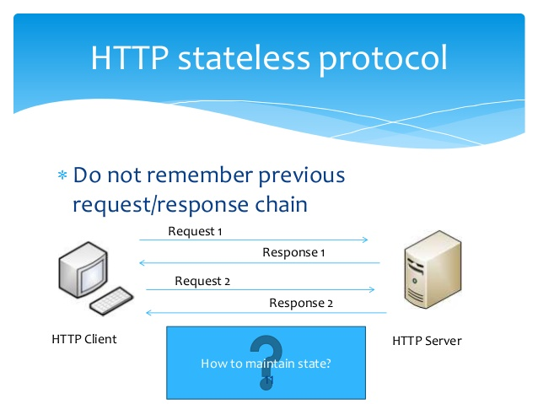
HTTP Stateless Protocol

Slide 5
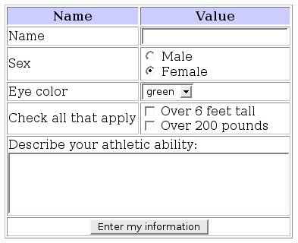
Stateless requests
Server
Browser
Web Server
PHP
Process 1
Process 2
Success

Slide 6
Stateless requests (2)
Server
Browser
Web Server
PHP
Process 1
Browser
Process 2

Slide 7
HTTP is a Stateless Protocol
Does not require the server to retain information or status for the duration of multiple requests
Some web applications may have to track the user's progress from page to page
Modern Web Storage API
HTTP cookies
Server side sessions
Hidden variables (when the current page contains a form)
URI-encoded parameters, e.g., /index.php?var=value

Slide 8

Client Side Storage

Slide 9
Local Storage and Session Storage
Not accessible through PHP, you need JavaScript to use them
// Save data to sessionStorage
sessionStorage.setItem('key', 'value');
// Get saved data from sessionStorage
let data = sessionStorage.getItem('key');
// Save data to localStorage
localStorage.setItem('favoriteflavor', 'vanilla');
// Get saved data from loaclStorage
let taste = localStorage.getItem('favoriteflavor');

Slide 10
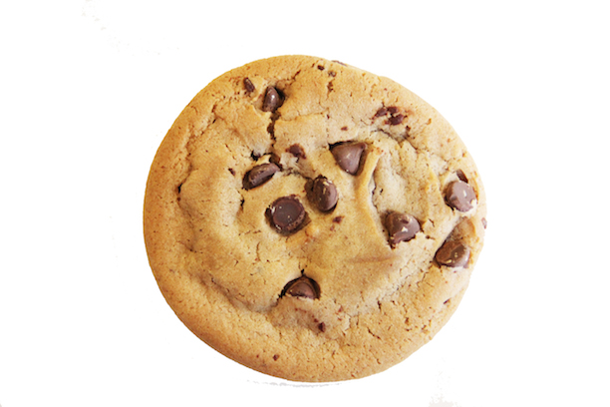
HTTP Cookies

Slide 11
HTTP Cookies
What is a cookie?
A piece of data that is embedded in the user's computer
Has name, value and timeout
Send cookies to be stored in the client's browser
Reading the cookies sent by the browser
$value = 'something from somewhere';
// expires in 1 hour
setcookie("TestCookie", $value, time() + 3600);
echo $_COOKIE["TestCookie"];

Slide 12
Cookies – Demo
<html>
<body>
<?php
if (isset($_COOKIE["user"])) {
echo "Welcome " . $_COOKIE["user"] . "!<br>";
} else {
echo "Welcome guest!<br>";
// expires in 60 seconds
setcookie("user", "Nakov", time() + 60);
}
?>
</body>
</html>
Must be called before any output to the browser

Slide 13

PHP Sessions

Slide 14
Storing Data with Sessions
Sessions preserve data between different HTTP requests
Implemented through cookies or URL propagation
$_SESSION is an superglobal array holding the session variables
Available after session_start()
Must be called before any output to the browser
session_start();
if ( ! isset($_SESSION['count'])) {
$_SESSION['count'] = 0;
} else {
$_SESSION['count']++;
}

Slide 15
Session Propagation
Cookie propagation – cookie containing the session id
Default and recommended behavior
URL propagation - the session id is propagated in the URL
Not recommended
PHPSESSID default cookie name
session_start();
echo $_COOKIE['PHPSESSID'];
<a href="nextpage.php?<?=SID?>">Next page</a>
SID is a global constant provided by PHP

Slide 16
Destroying a Session
// Clear all session variables
session_unset() // or $_SESSION = [];
// Delete the session cookie if there is one
if (isset($_COOKIE[session_name()])) {
unset($_COOKIE[session_name()])
setcookie(session_name(), '', time() - 3600, '/');
}
// Destroy session
session_destroy();
// avoid reusing the SID by redirecting
// back to the same page to regenerate session
header('Location: ' . $_SERVER['PHP_SELF']);
Remove the cookie now if you do not want to redirect
Always set date in the past

Slide 17
Session Considerations
By default, PHP sessions expire
It is possible to customize sessions so that they are maintained after the browser is closed – not recommended
Session Hi-jacking is more likely to succeed
File based sessions (the default in PHP) lock the session
In heavy AJAX web apps use session_write_close()
PHP allows creating a custom session handler
This is advanced stuff, never ever use it if unsure

Slide 18
Session Hi-jacking
A security issue: if a malicious user manages to get hold of an active session id that is not their own..
User 1 browsing site with cookies disabled (URL propagation)
User 1 logs in
User 1 sends an interesting link to user 2 by email. The URL copy and pasted contains his session id
User 2 looks at the link before session id is destroyed, and 'hijacks' user 1’s session
User 2 is now logged in as user 1!!

Slide 19
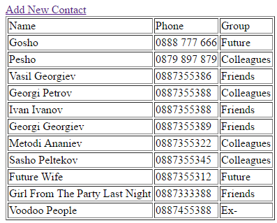
Problem: File Based Phonebook
Try to implement it with Sessions

Slide 20
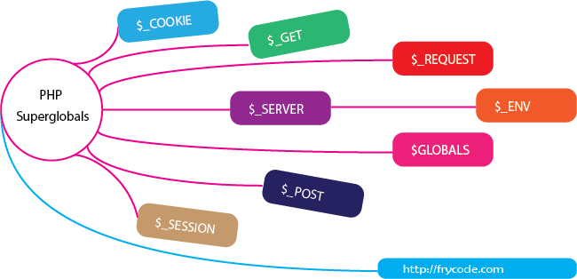
Other Superglobals in PHP

Slide 21
$_SERVER, $_REQUEST
$_SERVER – holds information about headers, paths, and script locations
$_REQUEST – an associative array that contains the contents of $_GET, $_POST and $_COOKIE
print_r($_SERVER);
print_r($_REQUEST);

Slide 22
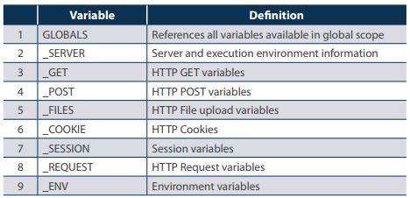
Other Superglobals
Live Demo

Slide 23

Authentication

Slide 24
Authentication
Authentication is the process of determining whether someone or something is, in fact, who or what it declares itself to be. Authentication technology provides access control for systems by checking to see if a user's credentials match the credentials in a database of authorized users or in a data authentication server.
Authentication in cybersecurity
Authentication is important because it enables organizations to keep their networks secure by permitting only authenticated users (or processes) to access its protected resources, which may include computer systems, networks, databases, websites and other network-based applications or services.
Once authenticated, a user or process is usually subjected to an authorization process as well, to determine whether the authenticated entity should be permitted access to a protected resource or system. A user can be authenticated but fail to be given access to a resource if that user was not granted permission to access it.

Slide 25
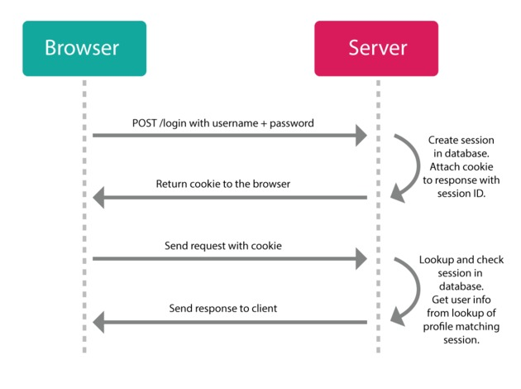
Authentication - Process

Slide 26

Summary
…
…
…
HTTP is a Stateless Protocol
Modern Web Storage API
JavaScript needed to use them
PHP can manipulate Cookies
Using PHP Sessions for data storage
Cookie or URL propagation
Using other PHP Superglobals: $_SERVER, $_REQUEST

Slide 27
https://softuni.bg/trainings/2163/php-web-development-basics-september2018/internal

Slide 28






СофтУни диамантени партньори

Slide 29






СофтУни диамантени партньори

Slide 30





Trainings @ Software University (SoftUni)
Software University – High-Quality Education, Profession and Job for Software Developers
softuni.bg
Software University Foundation
http://softuni.foundation/
Software University @ Facebook
facebook.com/SoftwareUniversity
Software University Forums
forum.softuni.bg

